Slide 1

National Response Directorate
Surface Operations Workshop
2020

Slide 2

Welcome
What this workshop provides:
  Policy Review
  Safety Enhancements
  It is NOT a replacement for TCT
  DO NOT ALTER this presentation
  – But you can add local information to the end
2

Slide 3
Ground Rules
This Workshop should be Interactive, NOT
all lecture
  Ask Questions
  Answer questions
  Share experiences (keep between the buoys)
  Share Insights
  Participate Participate Participate
3

Slide 4
Risk Management (RM)
Coast Guard (including Auxiliary) operations are inherently complex, dynamic, potentially dangerous, and, by nature, involve the acceptance of some level of risk
Risk MUST be continuously evaluated throughout every mission not just at the initial briefing
Mission plans and risk profile should be reported to OIA

Slide 5
Risk Management As A Way Of Life
We Continually Make Decisions Based on How Much Risk We Are Willing To Accept
  Personal
  Auxiliary
By Increasing Our Understanding Of Risk Management – We Will Increase Our Performance and Safety
Notes:
Risk must always be evaluated against the mission objectives. No Mission is so important that it supersedes any risk associated with accomplishing the mission.
Do not hesitate to cancel the mission or adjust mission objectives if the risk level grows to high. This (Risk assessment) is your responsibility to the mission just as much as accomplishing the mission itself.
Note to Instructor. On the “Marijuana is not legal for use under federal law” bullet there will be NO additional discussion or clarification

Slide 6
Risk Management
Risk Management is more than filling out a form or a process.
It is a mindset and awareness of risk and reward that can be used not only in your Auxiliary life but in everything that we do in our personal lives.
It is a Safety Culture!

Slide 7
What is Risk Management
A continuous, systematic process of identifying and controlling risk in all activities according to a set of pre-conceived parameters by applying appropriate management policies and procedures.
This process includes detecting hazards, assessing risk, and implementing and monitoring risk controls to support effective, risk-based decision-making.
Notes:
Risk Management is an ongoing, dynamic process. All members have responsibility to look out for one another and constantly evaluate risk vs benefit in all operations.

Slide 8
Risk Management As A Way Of Life
We Take Steps To Mitigate The Risks
  Ask for Help
  Modify Our Plans
  Reassess continuously
    Change Our Start Time
    Change Our Route
    Change Our Crew
  Check Our Equipment (be proficient, not just aware)
Notes:
You can never eliminate all risk, but you can always take stops to reduce risk.

Slide 9
Major Changes to RM
The Risk Management Instruction (COMDTINST 3500.3A)
Updates the RM process from 7 steps to the new 5 step process
Reintroduces the PEACE and STAAR models
Introduces the Risk Assessment Matrix (RAM)
Requires the use of GAR 2.0

Slide 10
PEACE Model
New GAR tool uses PEACE and scores the risk
Low –Medium - High
  Planning
  Event
  Assets - Crew
  Assets - Boat/Resources
  Communications/Supervision
  Environment
Notes:
No more numbers.

Slide 11
STAAR Model
Spread out – Disperse the risk by increasing time between events or using additional assets
Transfer – If possible, locate a better suited asset to conduct the mission
Avoid – Wait for risk to subside (daylight?)
Accept – Benefit should outweigh Risk
Reduce – Use PPE, additional training or rest, stress reduction

Slide 12
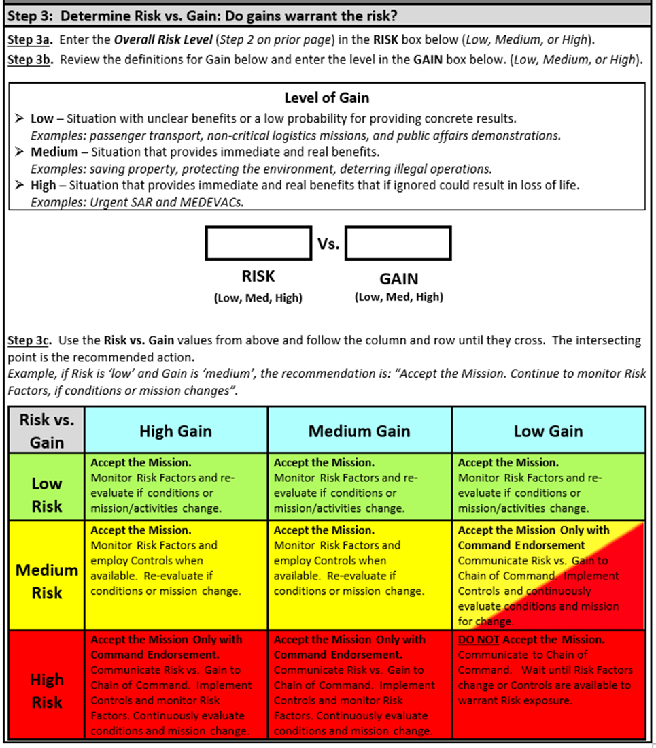
GAR 2.0 MATRIX
Notes:
The Coast Guard has three main versions of the Risk Assessment (GAR) form; Aviation, Ashore, and Afloat. The “Afloat” version is for large cutters, the “Ashore” version is for shore based units including small boats. Our surface crews can use either the afloat or ashore versions (the wording is the same).

Slide 13
What You Need to Do in Surface Operations
Complete the online “Introduction to Risk Management” training course 100202 (one time)
Attend “Annual Risk Management TCT Refresher”
  The training shall be delivered by certified facilitators
  New qualifications for Auxiliary TCT facilitator qualifications provided on BSX Policy Letter 19-03 (03 July 2019)
  Auxiliary facilitators (TCTAUX) should make annual TCT Refreshers more available
Notes:
An Auxiliarist must be approved through the Auxiliary chain of leadership. The DIRAUX is the sole authority for certification of Auxiliary TCT Facilitators.
Nominees will be selected based on proven performance, the ability to facilitate group discussions/foster open communications, and excellent grooming/uniform standards.
Nominees must also meet the following training requirements:
(1) Complete the Introduction to Risk Management course (100202)
(2) Complete the TCT Refresher as a student
(3) Certify as an Instructor (IT)
(4) Possess at least 3 years of relevant Auxiliary and/or professional experience.
Examples of relevant experience are: Surface Operations, Aviation, and Marine Safety qualifications, licensed mariners, professional experience in emergency services, safety/risk management, professional education, or military service. Forward any questions regarding relevant experience to the DIRAUX for consideration.

Slide 14
Mission Risk
Everyone on board should evaluate the risks
  Do we have the right facility for the mission?
  Is the weather within safety limits now and expected throughout the mission?
  Do we have the correct mix of crew/experience for the mission?
  Do we clearly understand our tasking?
  Am I ready/capable for this mission?
  Is the rest of the crew ready and capable for the mission?
Notes:
Remind everyone that anyone on the crew (or passengers) can cancel the mission at any time if they determine the risk outweighs the gain. It is not a group decision/majority rules situation. Everyone on board must continually assess their own physical condition as well and that of their fellow crew members.

Slide 15
I’M SAFE
Are you fit for your mission?
I = Illness - Do I have an illness or symptoms of illness?
M = Medication - Am I taking prescription or over-counter drugs?
S = Stress - Am I under psychological pressure from the job? Worried
about financial matters, health problems or family discord?
A = Alcohol - Have I been drinking within eight hours? Within 24 hours? Note: Marijuana is not legal for use under federal law
F = Fatigue - Am I tired and not adequately rested?
E = Eating - Am I adequately nourished?
Notes:
Everyone on the mission should go through this I’m Safe list and answer these questions honestly.

Slide 16
Training and Safety
Keys to Achieving Safety
Training / Crew Qualifications -Train for “Proficiency” not just enough to “qualify” or “re-qualify”
Use your Risk Management Tools
  PEACE, STAAR, GAR 2.0
Don’t just be a member of the “12 Hour Club”.
Always strive to exceed minimum training hours
Notes:
Consider every mission a training mission and learn from it. The 12 hour club is when a member only does the minimum required hours. This will not make for a proficient member of the crew. Instructors are to STRONGLY encourage “Proficiency”

Slide 17
Mishap Reporting
ALL mishaps must be reported to the Order Issuing Authority (OIA) immediately!
A Coast Guard mishap is defined as any unplanned, unexpected or undesirable event that causes injury, occupational illness, death, material loss or damage.
Additionally the Auxiliary requires any incident which causes a disruption or alteration of the mission reported.
This allows the mishap to become an education opportunity to be shared across the entire organization.
Notes:
Per COMDTINST_M5100.47.pdf - a Mishap is “An unplanned, unexpected, or undesirable event or series of events resulting in death, injury, occupational illness, or damage to or loss of materiel. “
Need to define MISHAP. Anything causing an unplanned stop besides a comfort stop is potentially reportable. Certainly any mechanical or maintenance issue, but people should use common sense in what they report. Anything that you expect to be reimbursed for should definitely be reported. That being said, it is better to over report than under report. Nobody will be criticized for reporting too much. When in doubt report it.
Operations Policy Manual requires those with firsthand knowledge of a mishap to report it. Let’s talk about that.
If you are confident that the principle parties are reporting to the organization, redundant reporting is not needed unless requested.
Why are they requesting that all mishaps; with or without injuries and even if there is no damage be reported?
Whenever a mishap occurs, even with no real damage or injury, is reported this information can be used to aid other members of potential risks and how this risk can be avoided.
This information you provided can be used as a learning or teaching event that can help all of us to become safer.

Slide 18
Mishap Reporting
Mishap report does not equal punishment
  However this does not apply for reckless or foolhardy actions
  Incidents occur
  Not reporting a mishap MAY lead to punitive action
All Districts must report summaries (no names) of damage & injury type mishaps to:
Roy Savoca, DIR-Rd email: roy@savoca.us
2020 Surface Operations Workshop Response Directorate

Slide 19
Coxswain Responsibilities Review
Obtain orders from OIA
Ensure currency:
  Of Facility Inspection
  Of Crew certifications
Responsible for ENTIRE crew
  From pre-mission brief to debrief
  Ensuring each member knows their role AND
is capable of filling that role

Slide 20
Coxswain Responsibilities
Designate primary lookout(s)
Exercise DIRECT supervision when facility is being operated by crewmember
Ensure that helmsman NOT leave the helm station
Ensure kill switches are used (when applicable)
Notes:
Crew fatigue is critical to the GAR score and cause to shorten or cancel the patrol entirely. The Coxswain should always endeavor to stay at or near the helm in order to be alert and in good position to respond to issues unless relieved by a competent crew member. Common sense applies when it is advisable for the Coxswain to change his/her position (e.g. head calls).
Maintaining a proper lookout is not only required for safe operations it is the law per the Navigation Rules. Do not just ASSUME everyone will pay attention and lookout for dangers

Slide 21
Coxswain Responsibilities
Ensure all crew members are capable of performing the mission
Ensure crew follows fatigue standards in Aux Ops Policy Manual
Ensure all crew are equipped with required PPE and are proficient in its use
Ensure PPE maintained in accordance with Maintenance Procedure Cards

Slide 22
Quote from Ops Policy Manual …
Each Auxiliarist is charged with an ongoing responsibility to use good judgment and common sense when evaluating their continuing ability to carry out their assignments. Each individual’s responsibility to exercise sound judgment requires each operator or crewmember, prior to departing on an ordered mission, to evaluate their own physical status and decline orders when unable to perform the required duties … It is incumbent upon the member to self-enforce; however, this does not always occur. It is critically important that the coxswain evaluate each crew member’s physical abilities prior to getting underway and this too does not always occur.
Notes:
It’s important to note that in the operations policy manual we already have statements saying it is
EVERY crew person’s responsibility to evaluate their own physical condition. Additionally the Coxswain is responsibility evaluate the condition of the crew before (and During) the start of the mission.

Slide 23
Quote from Ops Policy Manual …
It is the responsibility of each crew member to evaluate other crew members with regards to physical abilities to perform the tasks.
  The Operations Policy Manual contains the following:
In the event a crew member becomes aware of a physical or mental condition in one of the other crew members or in himself/herself, which may jeopardize the safety of the mission, said person has a responsibility for immediately bringing the condition to the attention of the coxswain, FC, and Director via the chain of leadership and the OIA.
Notes:
It goes on to state EVERY crew member should be aware of the condition of fellow crew members
In reality isn’t this a tenet of our TCT program
We need to do everything we can ensure this happens

Slide 24
Coxswain & Crew Responsibilities
Per the Ops Policy Manual, maintain awareness of physical limitations, i.e. vision & hearing acuity, in yourself and in others
  First line of defense – Coxswain during pre-underway briefing
  Second line of defense – crew continually observing each other during mission for physical limitations
  Third line of defense – QE check rides but that only happens once every three years
Notes:
Capable of performing the mission includes physical capabilities including vision and hearing acuity. Make the point that we are all to watch out for one another! The key is he crew, not the mission.

Slide 25
Crew Responsibilities Review
Safety is paramount
If you see something, say something
Use your Risk Management Tools
Remember ORM (Operational Risk Management)
Ensure you are well rested prior to getting underway
Notes:
ORM is all about a continuous review of changing conditions that may influence the “Risk” of a mission.

Slide 26
Important Reminders
Mobile Devices
  Use of Mobile Devices (phones, tablets) is PROHIBITED without permission from Coxswain (NEVER used by the helmsman)
    Ref: BSX Policy Letter (19-05)
  If necessary (and if Coxswain must use), come to dead stop to use mobile device
A Proper lookout must be maintained at all times
Notes:
If a facility is manned by a Coxswain and one crew, the facility must come to a full stop before the use of a cell phone or mobile device.
Important - cell phones can never be used by the person at the helm even if at dead stop because they need to be able to immediately react. The Cox’n can never use a device while the vessel is moving as they need to maintain full situational awareness.

Slide 27
Important Reminders
Radio Watch
  All vessels equipped with a VHF marine radiotelephone must maintain a watch on channel 16 whenever the radio is not being used to communicate. See National SAR Manual (COMDTINST M16130.2F) chapter 2 / SAR Communications, Paragraph 2.5.6 Channel 16 Monitoring Requirements (page 2-29)
  Do not simply monitor your ops channel (use dual watch, scan, or 2nd radio)
Notes:
NAVRULES require all vessels to maintain a listening watch on VHF 16 (unless under positive VTS control) whenever they are not using (meaning “transmitting”) the radio. We recommend all facilities have two installed VHF radios with one kept on VHF 16 at all times and the other used for operational control. If you only have one then use Dual-Watch or scan when not actively talking on it.

Slide 28
Important Reminders
Radio Communications
  In all radio communications, we are to act as professionals
  At no time shall we make reference to ethnicity, race, gender, sexual orientation or religious affiliations in radio transmissions
  This is a zero tolerance policy and must be strictly adhered to
Notes:
Note: physical descriptions (race, gender, etc.) ARE acceptable in transmitting if you are working a SAR case and that information is pertinent to prosecuting the case and finding or assisting the boater.

Slide 29
“Happen Upon” Policy Reminder
If you discover a vessel during routine patrol that requests assistance and that vessel has not been in contact with the Coast Guard or a private tow service:
  You may render assistance including tow if capable
  Notify the Operational Commander, identity the location and identity of the vessel and the intended towing destination
  If vessel is in danger and you are unable to safely tow, you may endeavor to safely remove persons from the vessel until additional help can arrive on scene
Notes:
You may tow if the vessel is in peril, or there are medical concerns.
You may not tow if a private salvor or towing company has been notified and is available in a reasonable timeframe in this case stand by until the salvor arrives. “reasonable” time has not been clearly defined so check with your OIA. Anything less than an hour would be considered “reasonable”
It must need assistance AND not have already contacted CG or a private tow service. You should not try to pick up the tow to “save them money” and take away business from a commercial tower.
You may pick up the tow to pull them to a safer location while they await the towing service.
You notify your Operational Commander of your intent to tow. If they need you on a higher priority task they will tell you that (see notes on next slide)
You do not need to ASK permission to tow.

Slide 30
“Happen Upon” Policy Reminder (Con’t)
  Coxswain decides on whether or not to assist vessel based on consultation with crew and risk assessment
  Inform your OIA of your intentions, not “ask for permission to tow”
  The CG SMC or OIA may override your decision if warranted by an evaluation of the circumstances or if your facility is needed on a higher priority task
Notes:
If the boater called for help you may also pickup a tow in some instances if a commercial tower is not available in a “Reasonable” amount of time.
From the CG Addendum 4.1.6.3.f
When specific alternate assistance is not requested or available, mariners will be informed that a broadcast can be made to determine if someone in the area can come to their assistance.
Coast Guard resources or Auxiliary vessels may also be directed to respond if no alternate responder can do so within a reasonable period of elapsed time. Factors governing the elapse of a reasonable period of time for assistance to arrive on scene are discussed below, but such a period should not normally exceed one hour from first awareness of the case.

Slide 31
Assistance to Auxiliary Facilities
Coast Guard resources or Auxiliary facilities may be used to help Auxiliary facilities in need of assistance at any time
An Auxiliary Facility is defined as an Operational Facility having a current accepted offer of use whether under orders or not
It is NOT just any boat owned by an Auxiliary member

Slide 32
Safety is ALWAYS Priority 1
Remember safety of the crew, the public, and the vessel are more important than the mission
PLB (Personal Locator Beacon)
  Have it on your person at all times when underway
  Check the battery expiration date and perform required monthly test per MPC
  Keep it registered with NOAA (every 2 years)
  As of 1 June 2016, all crew and coxswain on board must have/wear a PLB
HAZMAT
  Steer well clear of ANY HAZMAT situation unless you have a certified HAZMAT responder on your crew
Notes:
Please emphasize that safety is the top priority, and if the environment or other factors increase the risk…the GAR must be reviewed to determine what should be done to reduce the risk to an appropriate level. This includes aborting the mission if necessary.
*** All on board must be trained, equipped, and certified to handle Hazmat situations before you respond to this type of incident.

Slide 33
Provide SAR Response
Do only what you & your facility/crew are capable of.
Safety of your Crew Always Comes First
Operate at safe speed for the sea conditions and local environment
Observe all NO WAKE zones – set the example for all other boaters

Slide 34
AOM Reminders
Patrol orders are good for a 24 hour period from the first itinerary entry
Request multiple orders for multiple days – do not combine
Time in the itinerary must be consecutive with no gaps. One category ends at 1200, the next begins at 1200, Not 1201 or later

Slide 35
AOM Reminders (Con’t)
Mission Code 01D – Operational Standby, used for time when you are not underway but available such as:
  Prior to getting underway, crew prepping for mission
  When moored for meals, breaks, logistics stops
  Debriefing and cleaning up after a mission
Important since hours accumulated in 01D are included in calculating “crew fatigue parameters”
Notes:
Discuss the dangers of “crew fatigue”.

Slide 36
AOM Reminders (Con’t)
Training missions (22A) do not require a QE to be on-board
If on a QE check ride, use 22A and list the QE as required by your district and note in comments box the QE’s name and actual time doing QE activity
If a mid-patrol crew change, list all crew members and note times for each in the comments box. The coxswain and/or facility cannot be changed
The IS officer will adjust the entries in AUXDATA

Slide 37
AOM Reminders (Con’t)
Mission code 23A – SAR Standby
  Use only when specifically assigned by OIA to assume dedicated SAR standby or actual SAR mission
  Qualified crew must be in immediate vicinity of facility and in prescribed uniform.
  Examples: prolonged searches where Active Duty (AD) crews may exceed fatigue standards, AD assets not available, busy/holiday weekends

Slide 38
AOM Reminders (Con’t)
When requesting orders, always check the last
Facility Inspection Date
  If the patrol date will be 1 year + 45 days from the last inspection, a new offer for use must be submitted before the patrol. AOM will not allow order completion with an out of date inspection
  If the date you try to complete orders is over 1 year + 45 days from the last inspection, AOM will not allow completion of the orders, even if the patrol date was within the 1 year + 45 days

Slide 39
AOM Reminders (Con’t)
Meals are not automatically checked off - must be selected manually for each member
  Select only the meals that were actually consumed during the underway portion of the patrol, not before and after
  FINCEN does not pay for water, soda, snacks, etc.
  If you receive fuel or meals at no cost from the Coast Guard, check “Government Provided” box

Slide 40
AOM Reminders (Con’t)
Do not claim engine oil; it is included in your SAMA payment
  Fuel additives are 2-cycle oil, ethanol mitigation, injection cleaner, stabilizers, octane enhancer, etc.
  Include receipts as required. CG policy is $75; Districts may require receipts at a lower amount to include any and all claimed expenses
  Per the Operations Policy Manual, patrol orders must be submitted within 30 days after completion of the patrol

Slide 41
Subsistence Payment Reminders
Subsistence (meal) payments go to the Owner or Operator as selected on the order request
  The member receiving the subsistence payment is obligated to either
    Turn the payment over to each crew member or
    Provide a meal(s) to each crew member commensurate with at least the subsistence amount paid
  Subsistence payments are not to be kept by the owner or operator or put in a boat maintenance fund. This is what SAMA is for

Slide 42
New AUXDATA
New AUXDATA / AOM System
The functions of AOM will be incorporated into the new AUXDATA system
There will no longer be two separate systems
Patrol orders will be managed in the new AUXDATA system when it comes on line.

Slide 43
Additional Reminders
Any other special requirements from your local DIRAUX?
How about your OIA?

Slide 44
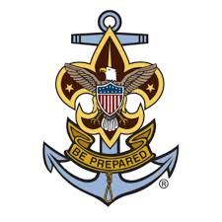
AUXSCOUT
Auxiliary-Sea Scout Youth Development Program
When involved with Sea Scouts, observe ALL provisions of the SOP published
01 November 2019
Notes:
The Auxiliary and the Sea Scouts identified significantly beneficial prospects of enhancing their partnership including improved Sea Scout training opportunities, enriched Coast Guard and Auxiliary recruiting, and better overall promotion of recreational boating safety among our Nation’s boating public.
There are specific requirements when working with Sea Scouts that need to be followed,
Consent Forms
Required training specified training as defined in the SOP
Limitations in participation in SAR activities
Qualifications open to sea scouts
Refer to the SOP published 1 November 2019 for requirements and details

Slide 45


Bravo Zulu!
Great Job!
Thank you for your participation in the 2020
Surface Operations Workshop.
Please share your thoughts and feedback about this workshop with us.
Send your comments to:
Division Chief, Operations Projects and Educational Outreach Bruce.Pugh@cgauxnet.us
Bruce Pugh, DVC-RE
Rick Saunders, DIR-R
Roy Savoca, DIR-Rd
Notes:
V2.1FinalO

